Slide 1
Word Embedding & Attention
王冰丰
2019年08月05日

Slide 2
Outline
ELMo
Attention
Attention Over Attention

Slide 3
ELMo

Slide 4
ELMo
Embeddings from Language Models
Deep Contextualized Word Representations
y=f(word, context)
Embedding
Neural Network
Words as fundamental semantic unit

Slide 5
ELMo
Two Features:
Complex characteristics of word use
How these uses vary across linguistic contexts
Character Embeddings
CNN
Highway Network
Output
BiLMs

Slide 6
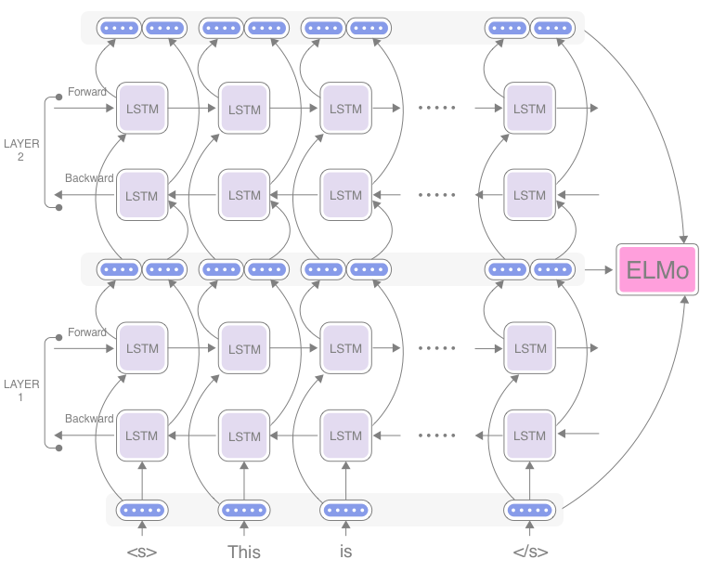
ELMo
BiLMs

Slide 7
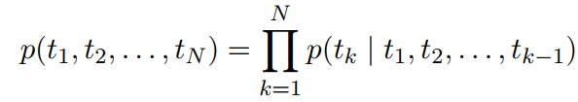
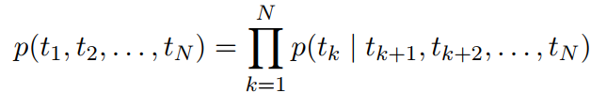
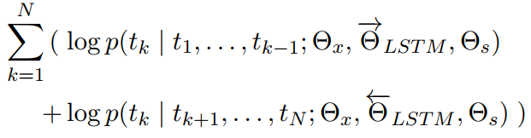
ELMo
Bidirectional Language Model
Forward LM
Backward LM
Joint loss function

Slide 8
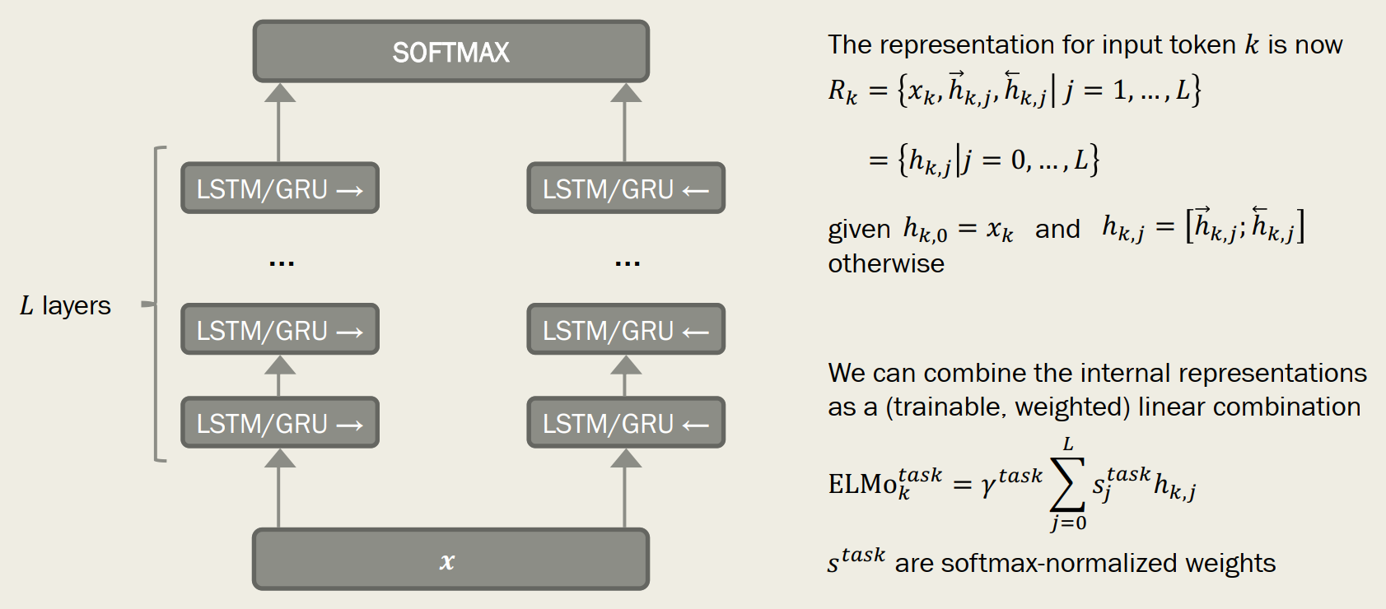
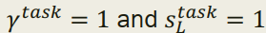
ELMo
Architecture

Slide 9
ELMo
Character Embedding
Instead of words, ELMo use sub-word units(e.g. characters), and pass them through a CNN before presenting the now-dense representations to the architecture.

Slide 10
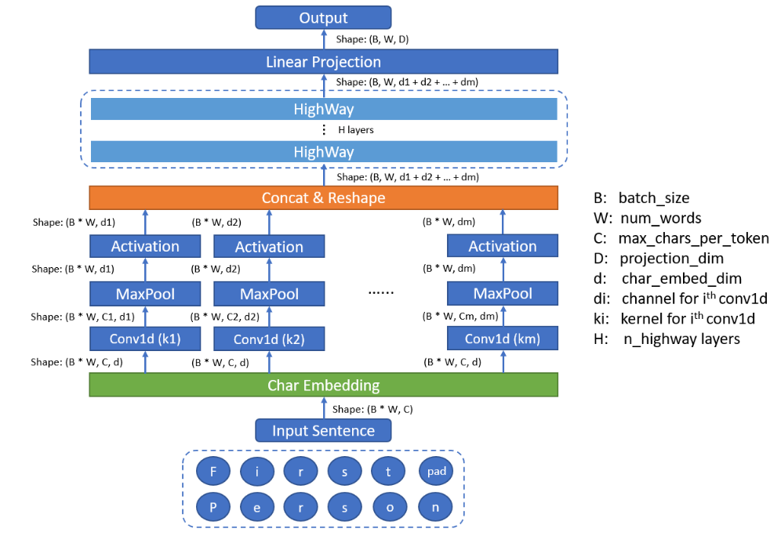
ELMo
CNN

Slide 11
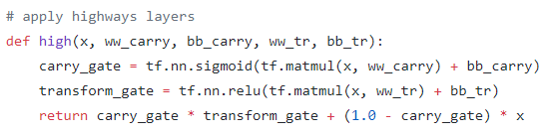
ELMo
Highway
x
sigmoid
1-
X
o
relu
X
+

Slide 12
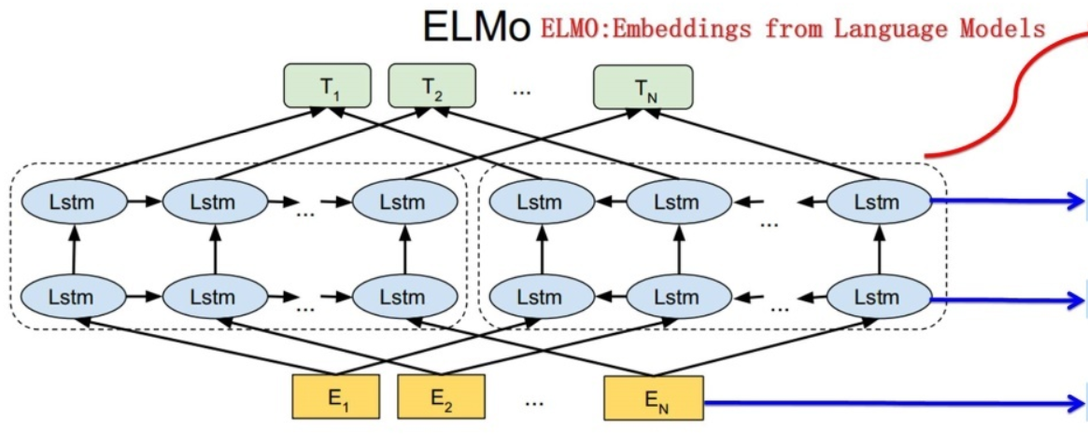
ELMo
Application
Pretrained model use two layers lstm.
Word meaning
Syntax
Word feature

Slide 13
Attention

Slide 14
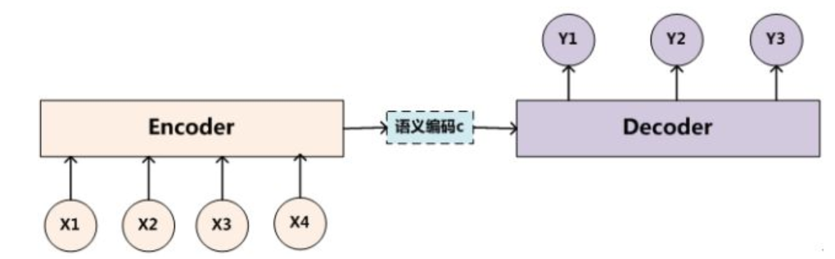
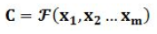
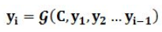
Attention
Encoder-Decoder model

Slide 15
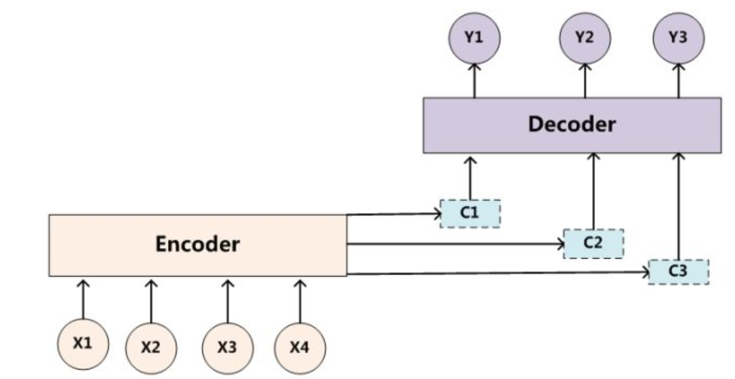
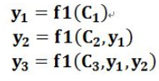
Attention
Soft Attention

Slide 16
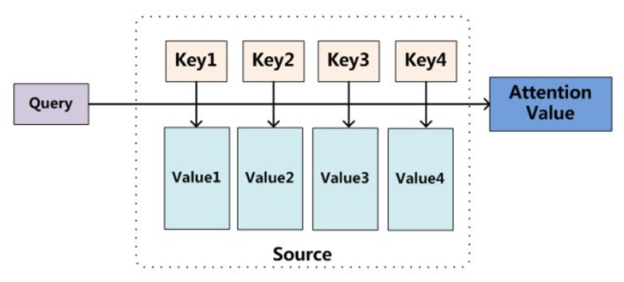
Attention

Slide 17
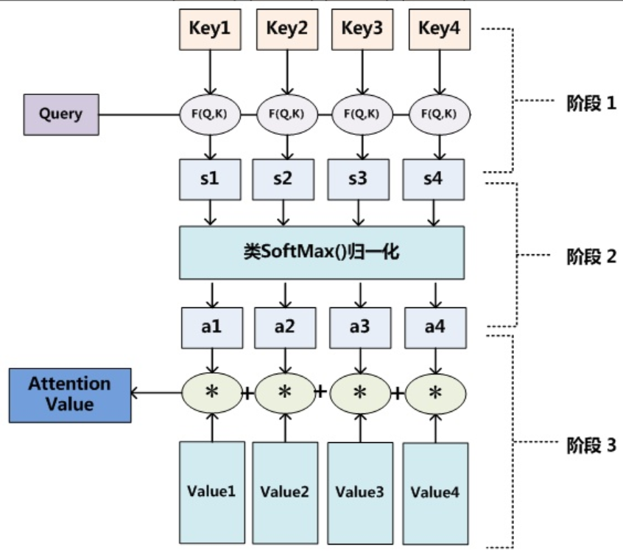
Attention
Phase 1
Softmax
Phase 2
Phase 3

Slide 18
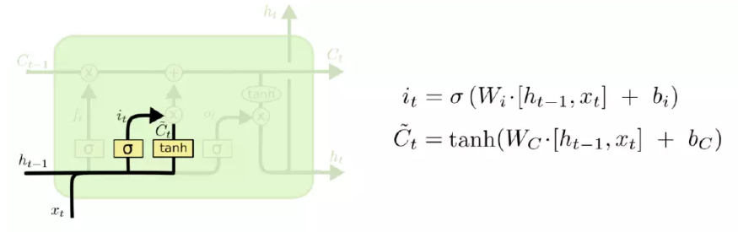
RNN
LSTM (input gate)

Slide 19
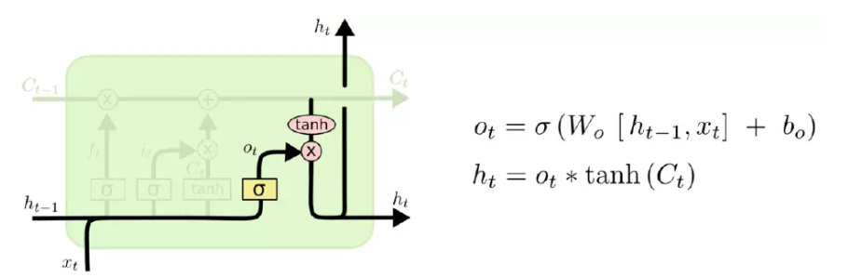
RNN
LSTM (output gate)

Slide 20
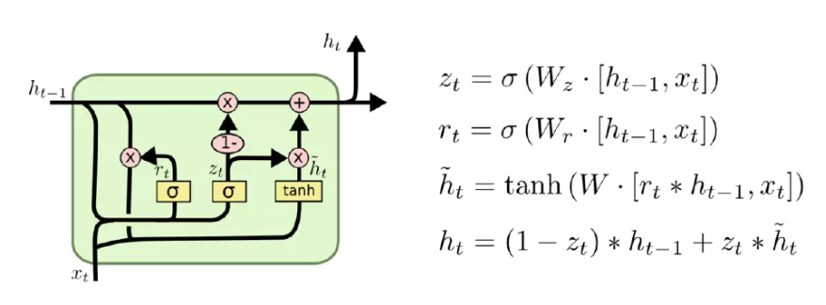
RNN
GRU

Slide 21
Word Embedding

Slide 22
Word Embedding
One hot representation
Distributed representation

Slide 23
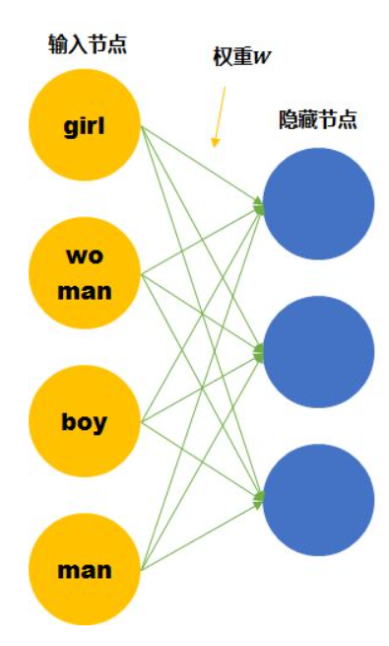
Word Embedding
One hot representation

Slide 24
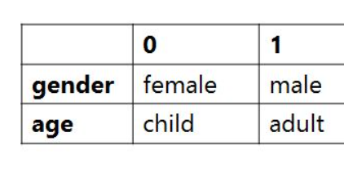
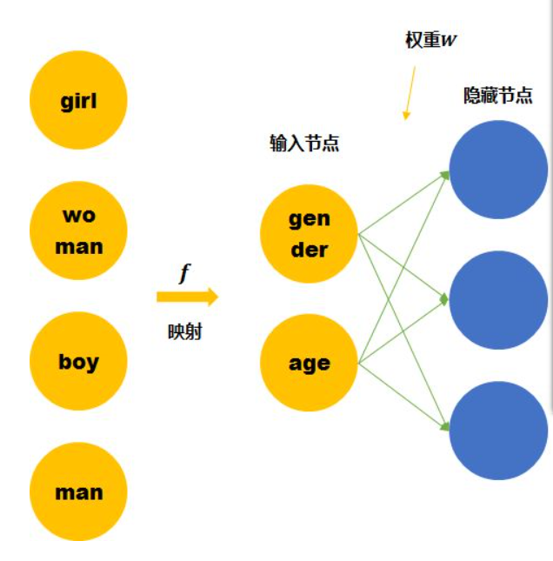
Word Embedding
Distributed representation

Slide 25
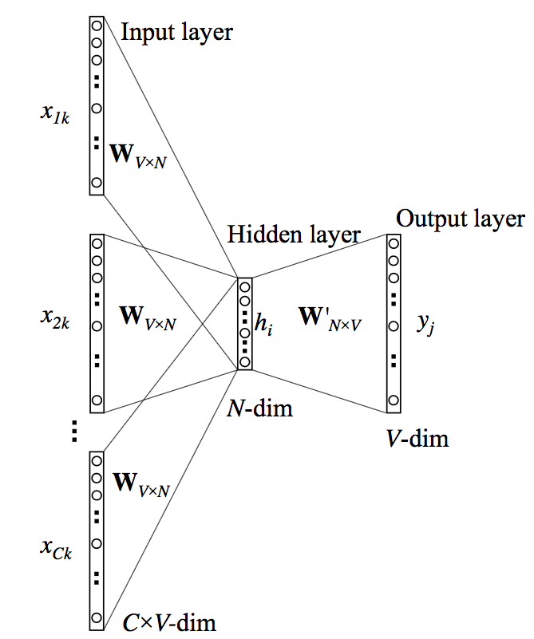
Word Embedding
CBOW

Slide 26
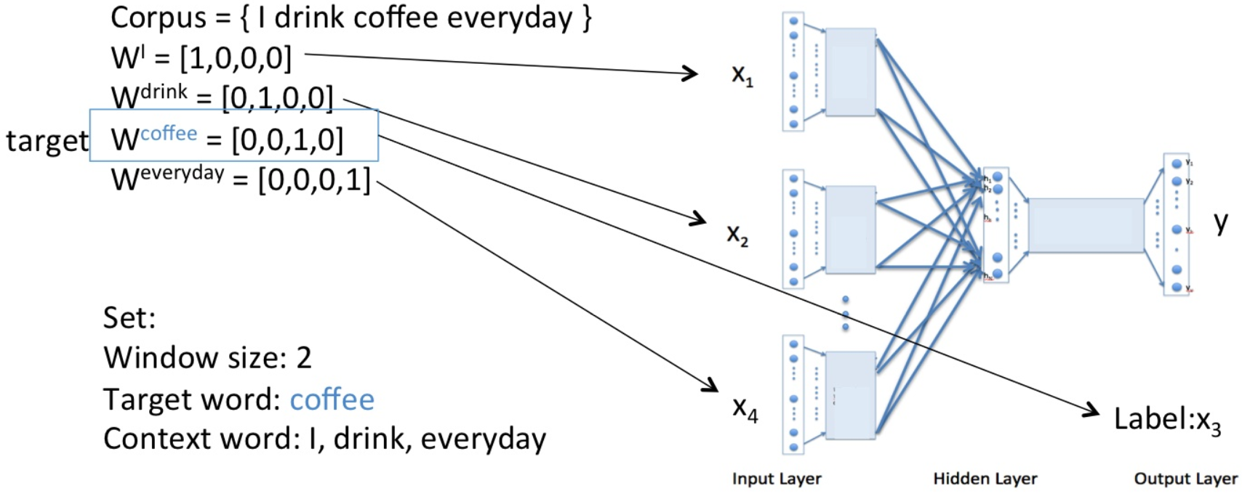
Word Embedding
CBOW

Slide 27
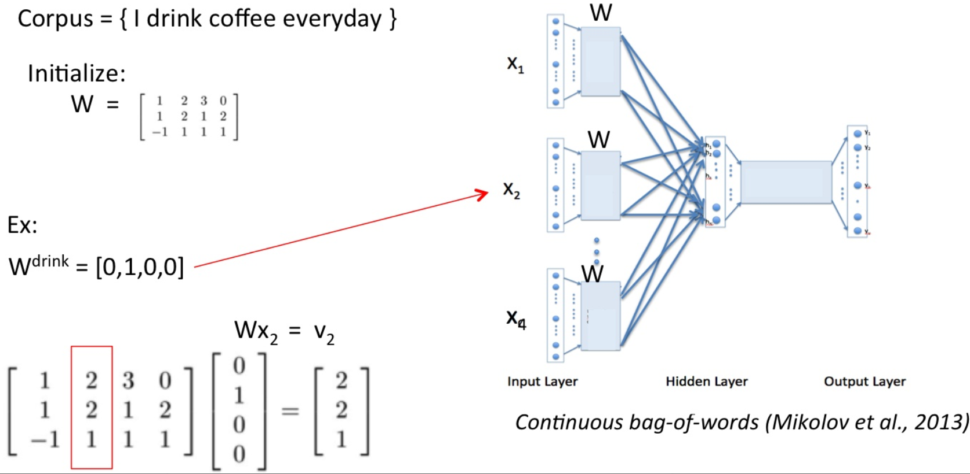
Word Embedding
CBOW

Slide 28
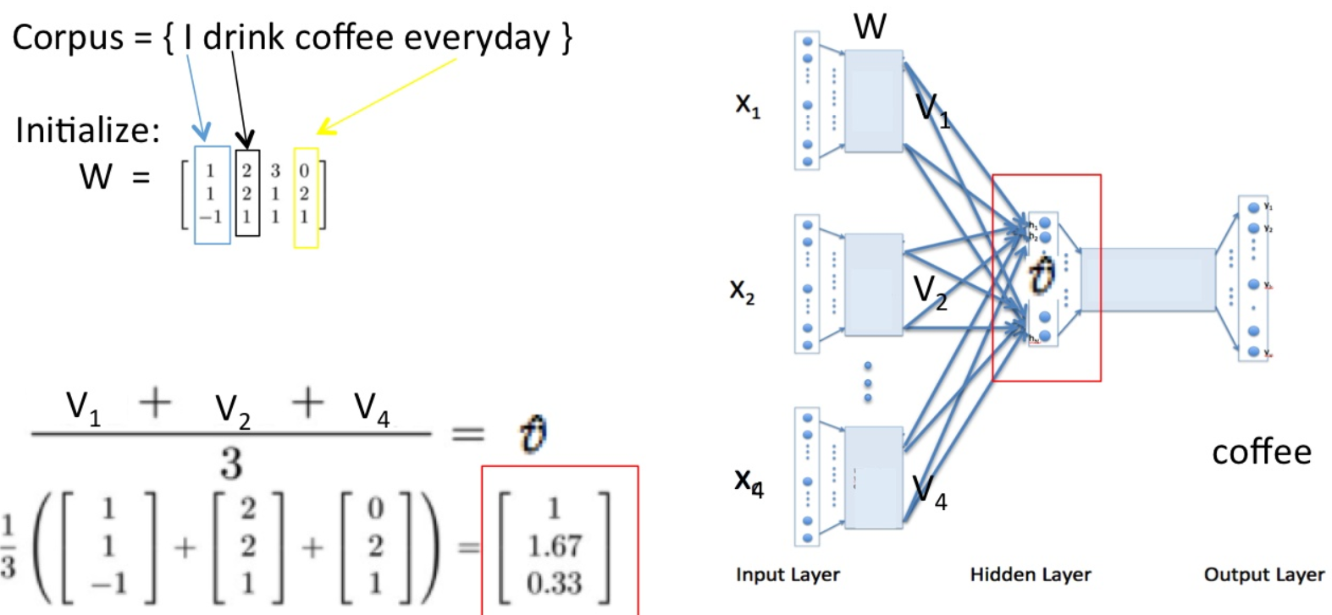
Word Embedding
CBOW

Slide 29
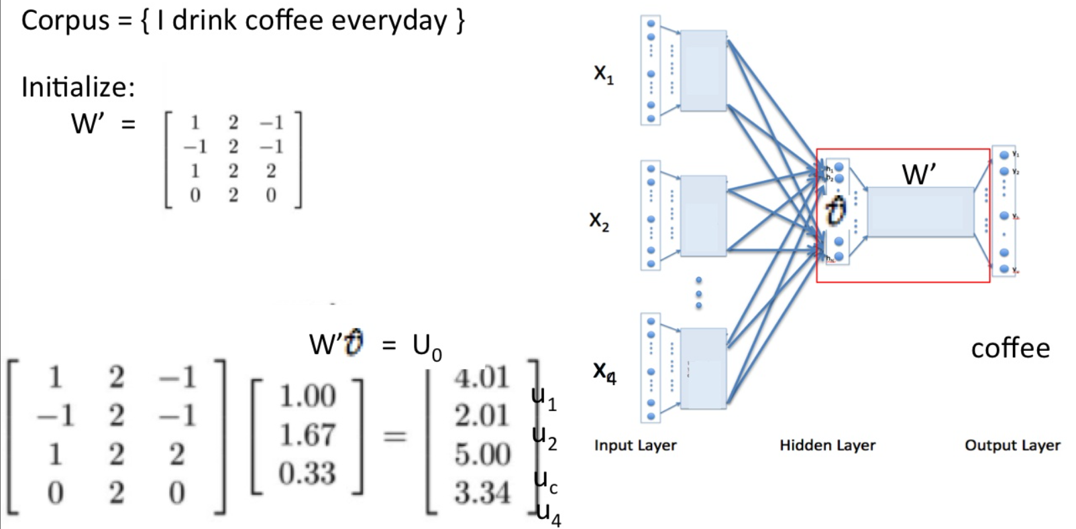
Word Embedding
CBOW

Slide 30
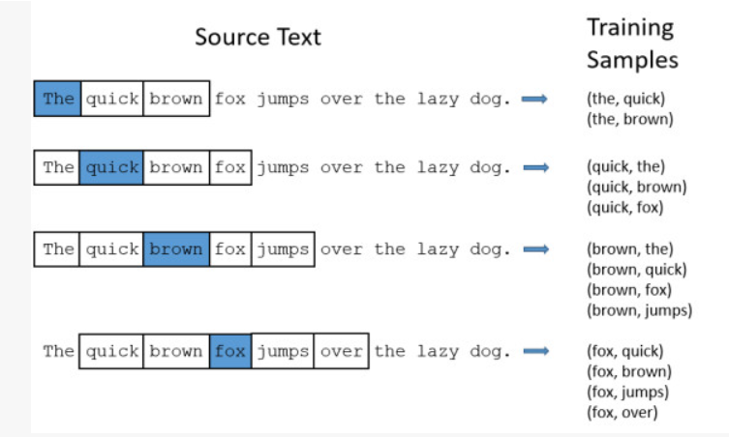
Word Embedding
Skip-gram

Slide 31
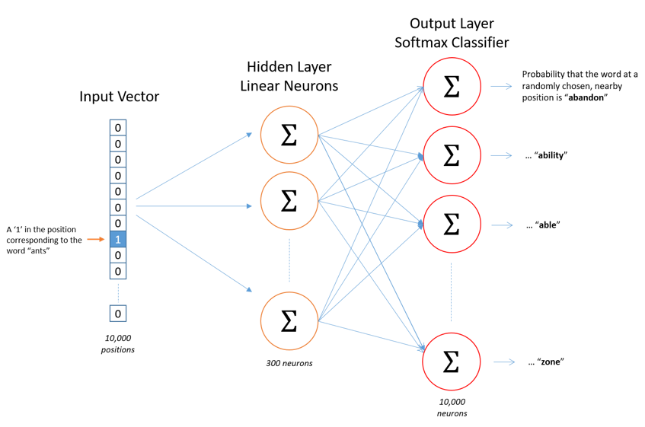
Word Embedding
Skip-gram

Slide 32
Research Orientation

Slide 33
Research Orientation
Machine Translation
Information Retrieval
Information Extraction
Sentiment Analysis
Question Answer
Few-shot Learning

